Slide 1

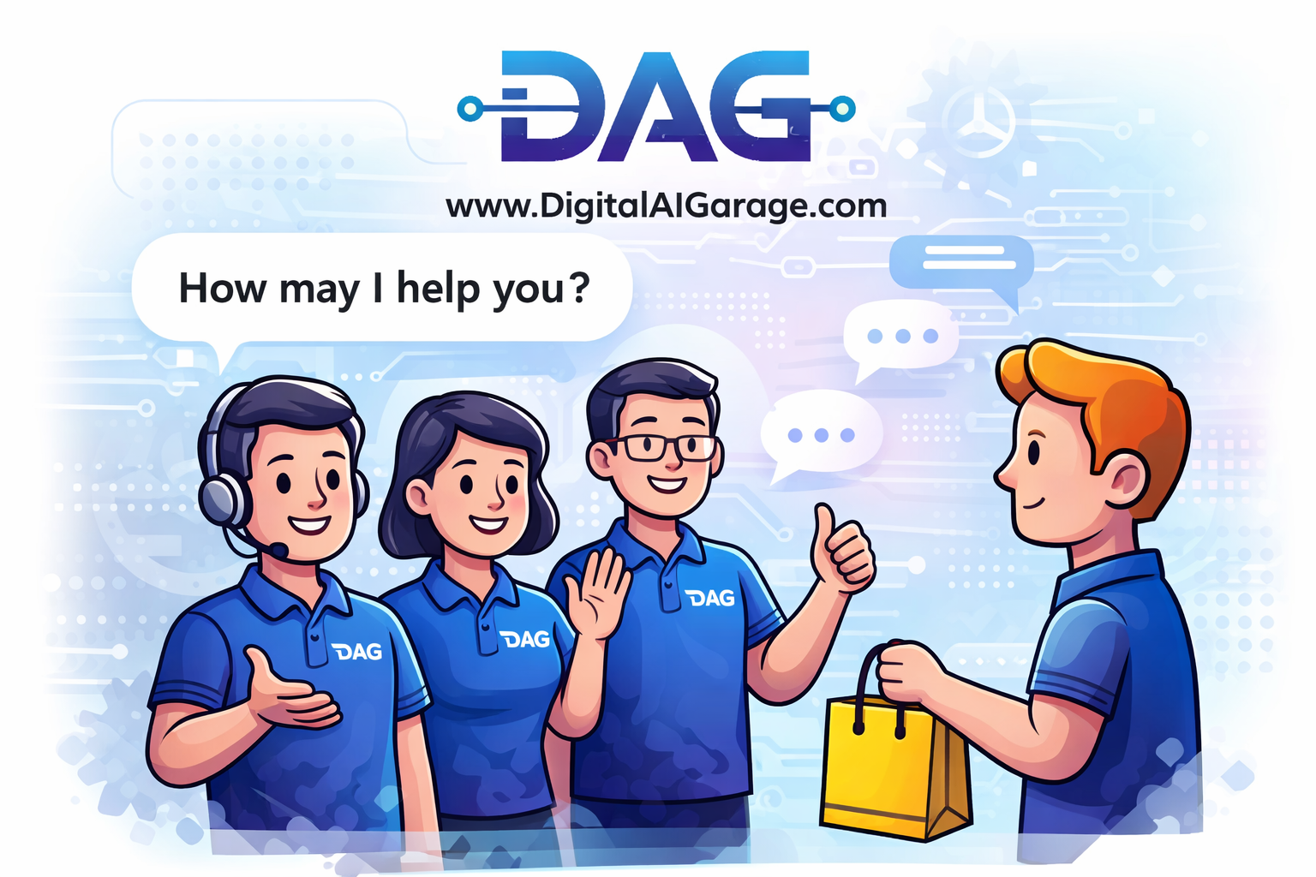
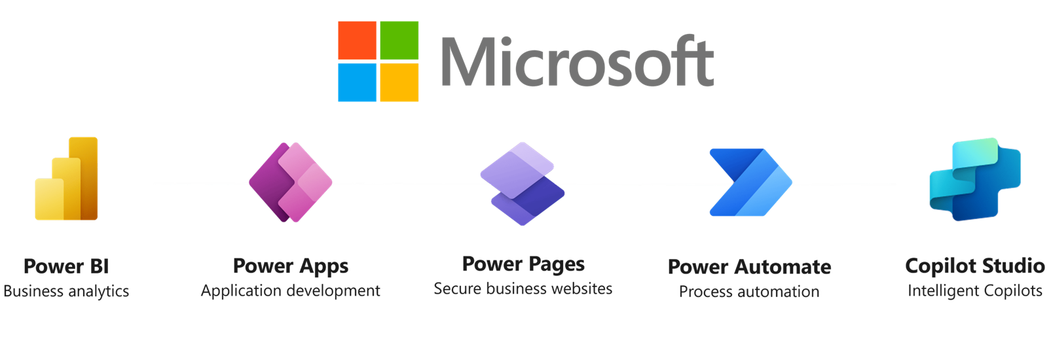
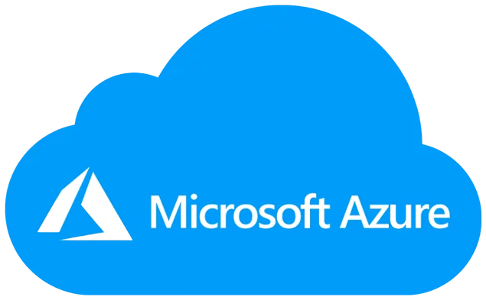
Business Process Digitization leveraging Microsoft Power Platform + Azure
www.DigitalAIGarage.com
Notes:
We, at Digital Garage, are committed to solve our customer’s business challenges, via Technology enablers such as Microsoft Power Platform. We help customers in their journey of Digital Transformation led growth. Microsoft Power Platform has more than enough tools, in its arsenal to solve, evolving, growing and compounding, Digital needs of growing businesses. Enterprises of all sizes can leverage this platform, to build any digital solutions, exactly as per their business and process need.

Slide 2

2
Customer

Slide 3
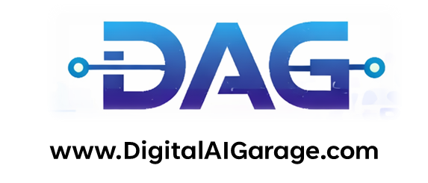



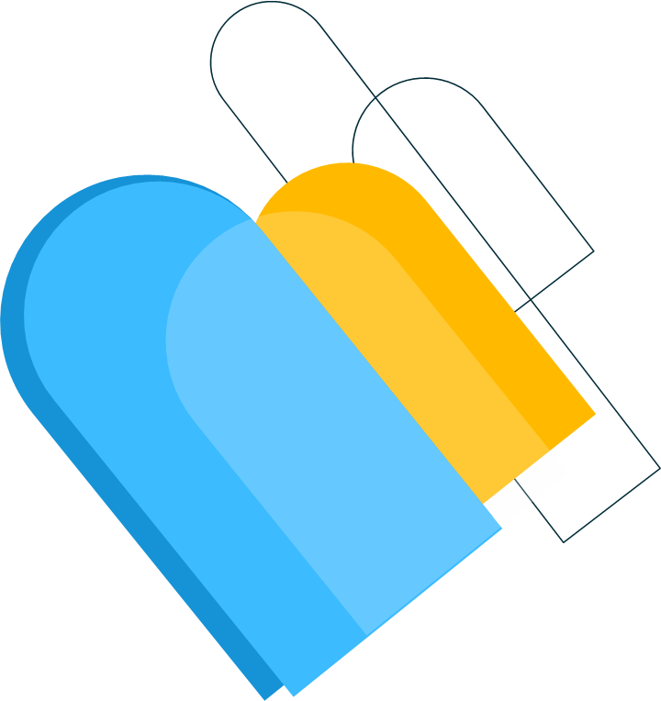
What do you do ?
What kind of processes can be digitized ?
We enable organizations to digitize and automate their business processes
Any structured, repeatable business process that involves multiple stakeholders, decision points, data capture, or approvals can be digitized. In short, processes that
Involve multiple people or departments
Require complex workflows or sequential approvals
Need role-based or security-based access control
Depend on manual data entry or paper-based documentation
Require tracking, audit trails, or compliance monitoring
Involve repetitive tasks that can be standardized
Require integration across systems (ERP, CRM, HRMS, etc.)

Slide 4
Is it only Digitization ?
CRM, ERP is also a process, Can you create one as per my need ?
Yes. In fact, few of our customers are already using our custom-built CRM solutions.
Our CRM systems are not only highly cost-effective, but also fully tailored to each organization’s specific processes, workflows, and reporting requirements.
We design them to align with your business model — not the other way around.
No — it goes beyond digitization. It involves Digitization, Automation, and Integration.
Digitization converts manual or paper-based processes into structured digital workflows.
Automation reduces human intervention by automatically triggering actions, approvals, notifications, and validations.
Integration connects systems (ERP, CRM, finance, HR, etc.) so data flows seamlessly across platforms without duplication or manual re-entry.
Which technology stack you use ?
Microsoft Power Platform, Azure Cloud Services & Open stack for frontend

Slide 5
Ok how can I begin my journey with You ?
Why only Microsoft ?
Start small
Identify a simple, high-impact use case within your organization — something manual, repetitive, or approval-driven.
We can rapidly build a focused solution to address that specific need.
Once you see the value, gain confidence, and experience measurable results, we can gradually scale the solution — expanding automation, integrations, and digital workflows across departments.
Digital transformation doesn’t have to start big. It just has to start smart.
This was a deliberate strategic decision. Rather than spreading ourselves across multiple platforms, we chose to specialize in one enterprise-grade ecosystem.
Microsoft provides a comprehensive, integrated platform. By going deep instead of wide, we deliver greater quality, faster execution, and more reliable outcomes for our clients.

Slide 6
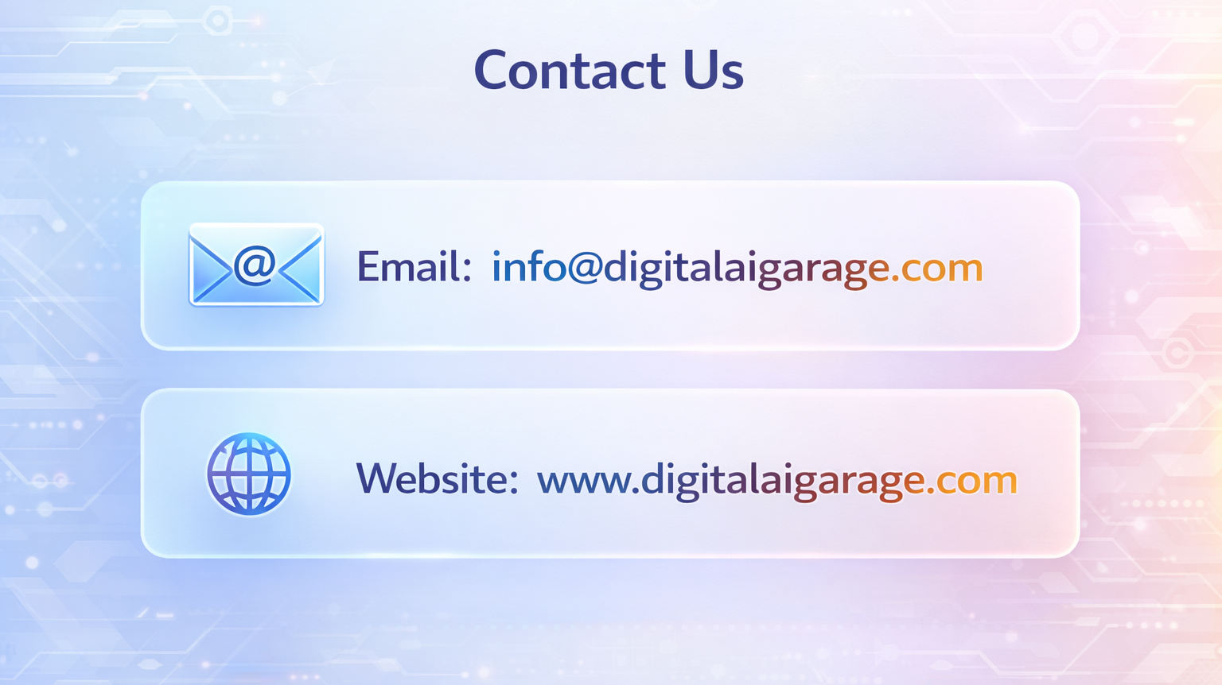

Slide 7
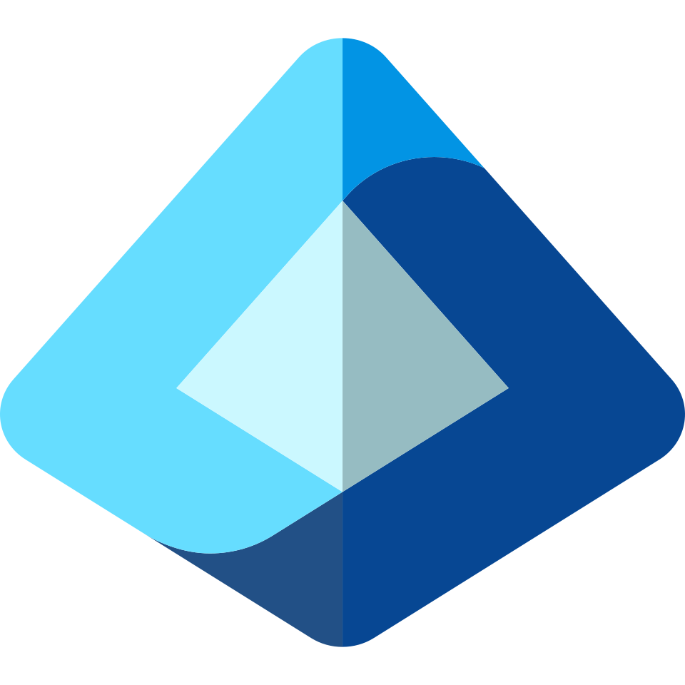

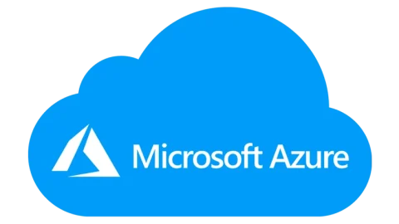
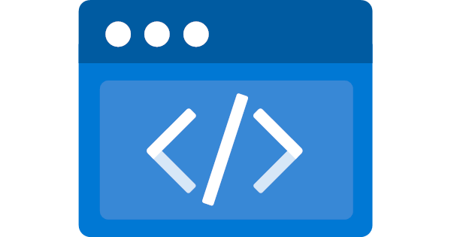
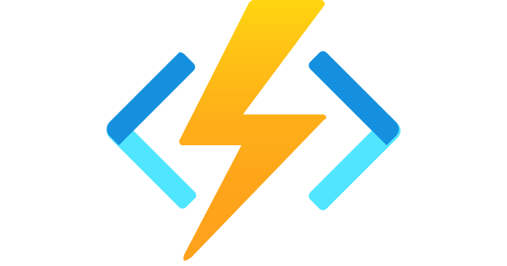

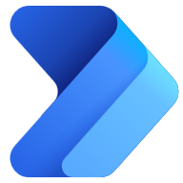
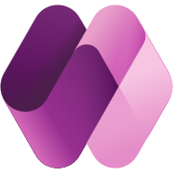
Digital Transformation On Microsoft Ecosystem
Microsoft Entra (External for Customers & Vendors)
External Facing Dynamic Websites
Internal Website
Azure Static Web App
Customer Portal
Vendor Portal
Training App
Azure Functions
6
7
8
With Dataverse as DB
30+ Automations
Integration with Company Website, IVR, WhatsApp etc., Azure cloud Services
Power Automate
------------------ Automation & Integration Layer --------------------
SALES CRM
Vendor WA
Customer
Management
Project
Management
Procurement
Power Apps
1
2
3
4
5
For Internal Users
Microsoft Dataverse as Underlying Database

Slide 8
We delivered a comprehensive digital transformation solution for our client by designing and implementing an integrated business platform built on the Microsoft ecosystem. The objective was to replace fragmented systems with a centralized, scalable, and automation-driven architecture powered by Microsoft Power Platform, Azure, and Microsoft Dataverse.
The solution unified external customer portals, vendor portals, internal business applications s.a. CRM, Project Management, Customer Management, and enterprise automation workflows into a single secure Microsoft cloud environment.
Key outcomes included:
Deployment of dynamic customer and vendor portals
Implementation of custom CRM and business applications
30+ automated workflows using Power Automate
Centralized data management using Microsoft Dataverse
Seamless integration with website, IVR, WhatsApp, and Azure services
Enterprise-grade security with Microsoft Entra
The transformation resulted in improved operational efficiency, better data visibility, enhanced customer engagement, and scalable cloud-based infrastructure.

